Slide 1
Azure IaaS Advanced 9WK15 Intelligent Cloud Bootcamp
Andreas Mock Cloud Solution Architect github.com/
AndreasM009
Bernhard Frank Cloud Solution Architect blog: aka.ms/bfrank
WLAN: Event:
Notes:
Dieser 1-tägige Workshop dient zur Vertiefung des Wissens um Azure IaaS Funktionalitäten.
Azure Grund-Kenntnisse werden vorausgesetzt (wie z.B. beim Training "Azure Fundamentals" vermittelt werden).
Aus dem Inhalt:
Worauf sollte man bei der Erstellung von VMs achten? (Größe, Durchsatz, Ausfallsicherheit)
Wie skaliere ich meine VMs (VM Scale Sets)?
Brauche ich noch Storage Accounts (insbes. Blob Storage)
Was sind die Unterschiede zwischen Storage V1 und Storage V2?
Wie mache ich Azure Automation mittels Automation Runbooks?
Automatisierung und Anpassung von VMs mit Custom Script Extensions.
Einführung in ARM-Templates.
Erstellung von VMs und Ressourcen (VNET, Storage, Subnet, VMs) mittels Powershell
Ziel des Workshops ist es komplexere Azure Infrastrukturlösungen ausfallsicher zu planen und wiederholbar bereitstellen zu können.
Bitte bringen Sie einen Laptop mit Windows 10 für praktischen Übungen mit.
Weitere Trainings und Veranstaltungen für Partner finden Sie auf dem Partner Enablement Portal.

Slide 2

Link Collection aka.ms/azurequickstart

Slide 3
Partner Information & Materials www.microsoftpartnerserverandcloud.com

Slide 4

Agenda - Challenges
Create VM using PowerShell
Multiple Data Disks
Custom Script Extensions
Create VM Scale Set
Azure Automation
Attach VMSS to AA State Config DSC
Azure Resource Manager
Usage API - RateCard API
Azure File Sync
Container / Orchestrator / DevOps

Slide 5
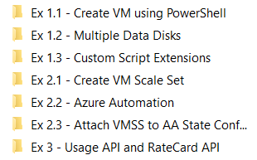
Labs
https://github.com/CSA-OCP-GER/IaaS-Advanced

Slide 6
Virtual Machines
Ubuntu, Red Hat, Windows, SUSE, CoreOS
Quick resize through reboot
Local temp storage (HDD or SSD)
Azure Storage for OS and data disks
Hundreds of items in marketplace

Slide 7
Compute Options for all Types of Apps
Entry level
Burstable
General Purpose
Compute Intensive
Storage Optimized
A
Av2
B
D
Dv2
Dv3
F
Fv2
L
Memory Optimized
Graphics Intensive
High Performance Computing
Purpose-built SAP HANA
G
Ev3
M
NC
NCv2
NV
ND
H
HANA
NCv3
NCv2
NCv2
(coming soon)
(coming soon)

Slide 8
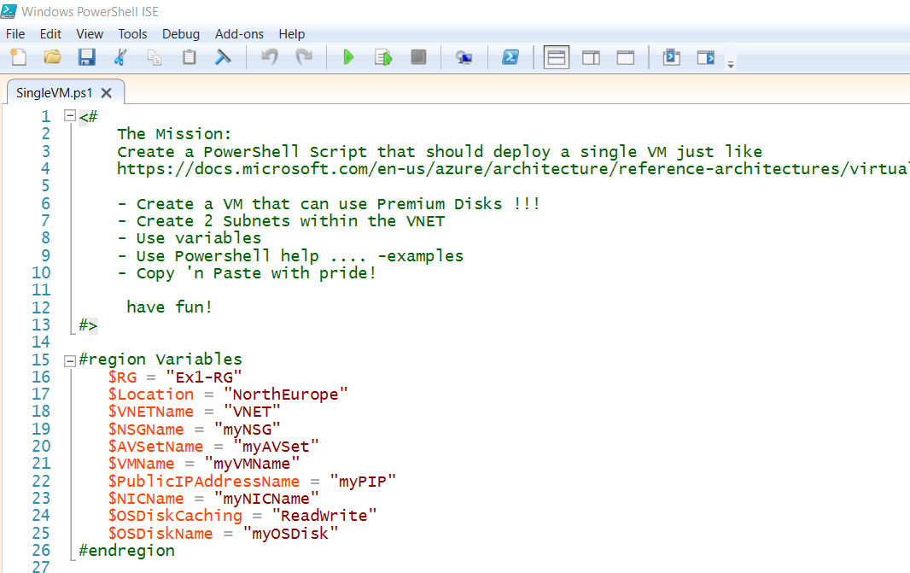
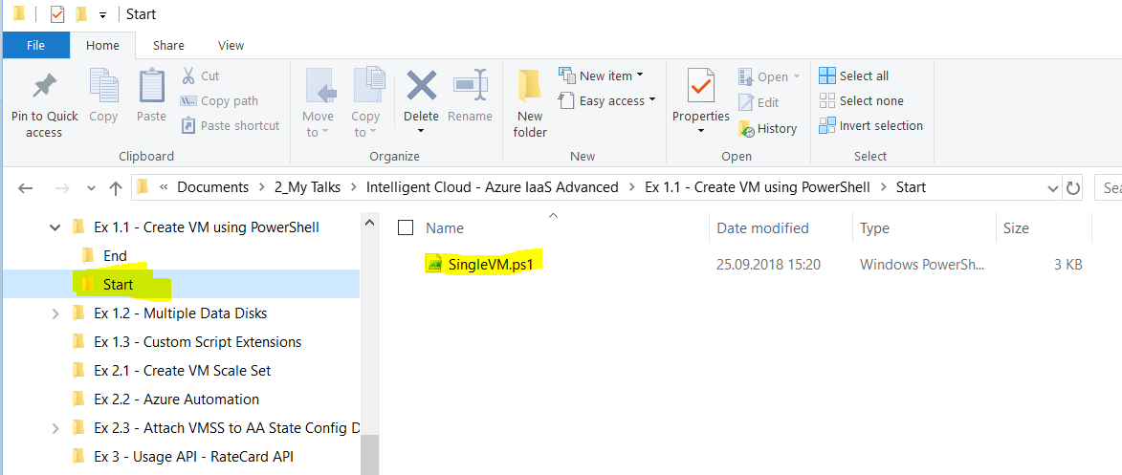
1.1 Create VM using PowerShell
Start here and use ISE VScode,…to fill the gaps

Slide 9
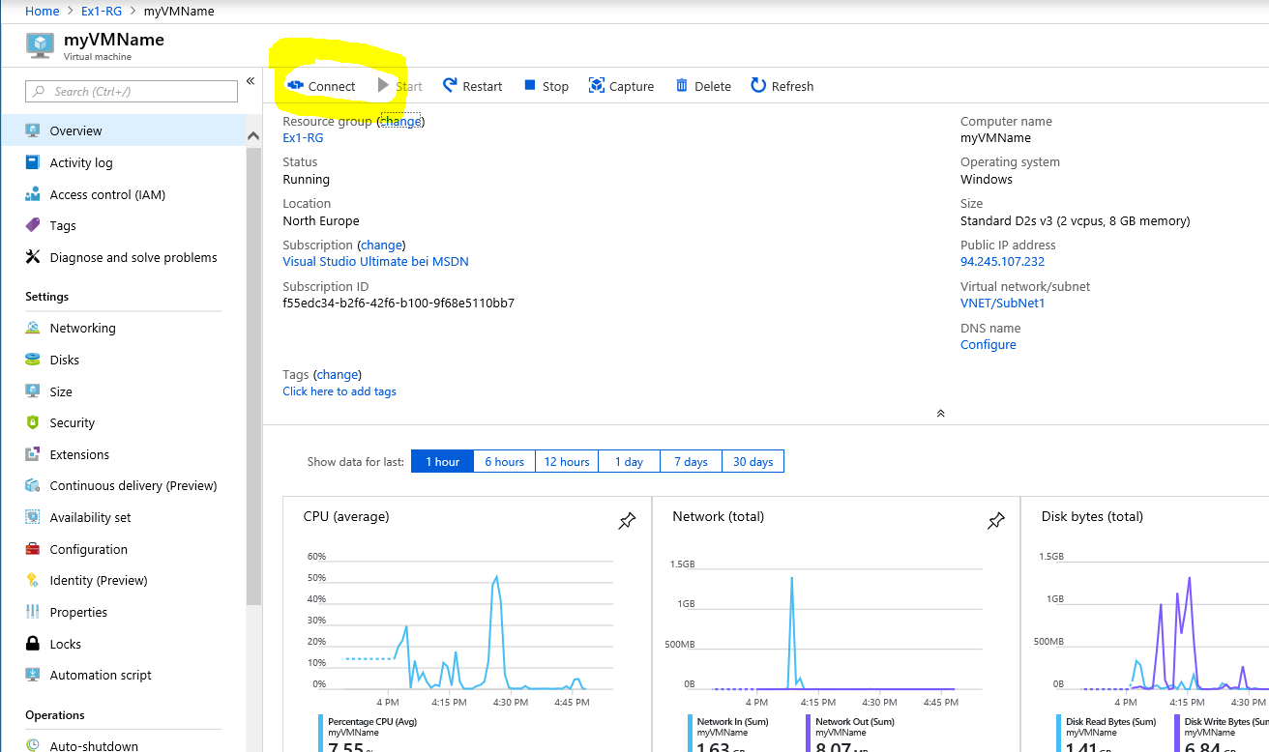
Ergebnis 1.1 Create VM using PowerShell

Slide 10

What are Managed Disks?
Simple – Abstracts storage accounts from customers
Managed by Azure
Granular access control – Top level ARM resource, apply Azure RBAC
PAGE BLOBS
Better performance – Storage account limits do not apply
OS disk
Data disk
Big scale – Up to 10,000 disks per region per subscription
Managed Storage accounts

Slide 11
Managed Disks – Best Practices
Use SSD Disks for Production workloads
Only Managed Disks for new workloads
Upgrade legacy unmanaged to managed when possible
RAID for redundancy is not necessary
RAID/StorageSpaces for performance as needed
Durability doesn’t remove the need for backups
Performance
Local SSD is definitely temporary, use if you can tolerate loss
Enable read caching where appropriate for better performance
Understand VM limits vs Disk limits vs Network throughput limits

Slide 12
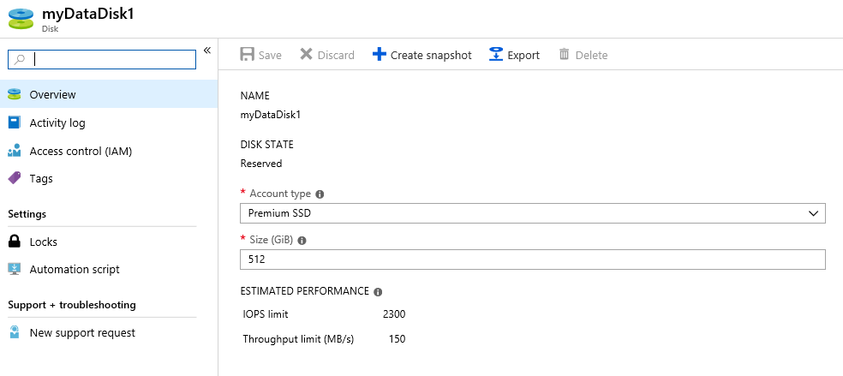
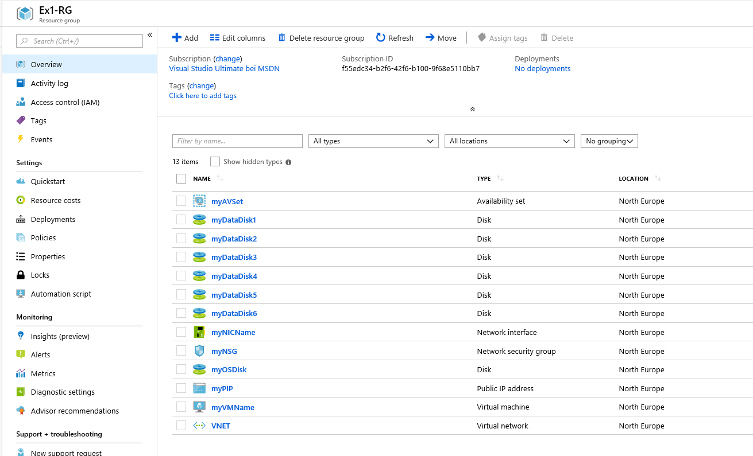
1.2 Multiple Data Disks
Create and attach 6 premium disks to the VM – use portal or Powershell

Slide 13
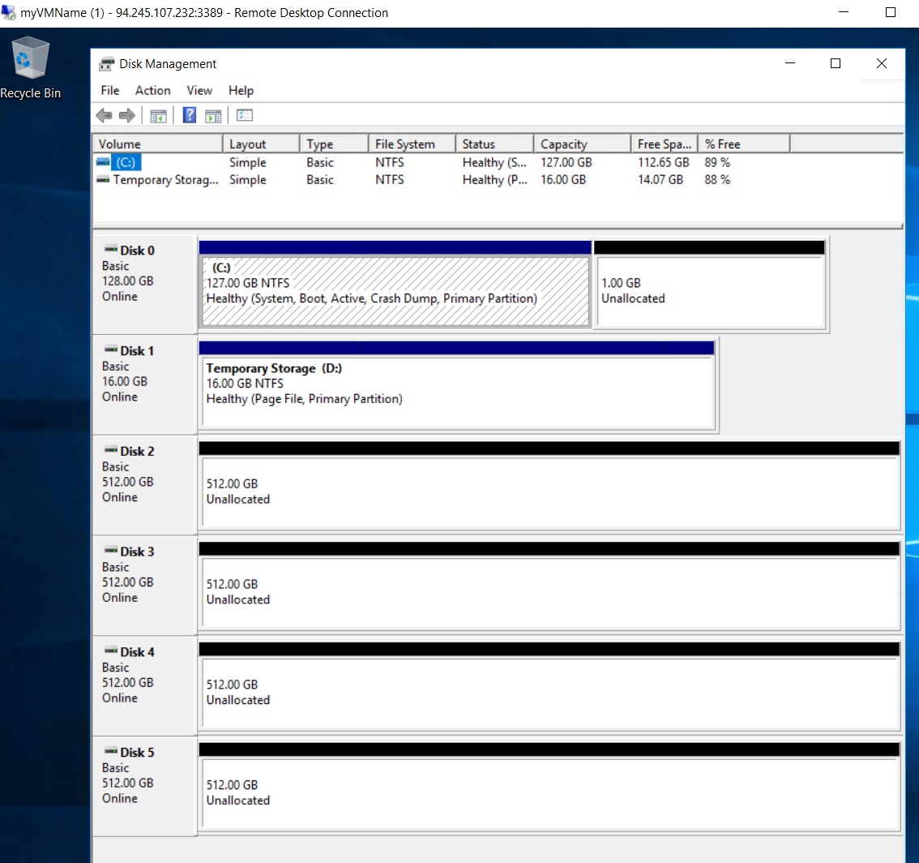
Ergebnis 1.2 Multiple Data Disks
Die VM sollte so o.ä. aussehen.

Slide 14

1.2 Multiple Data Disks Fragen…
Welchen VM Typen brauche ich um Premium Storage zu verwenden?
Was mache ich wenn ich den ‘falschen’ VM-Typen verwendet habe?
Wieviele Datendisks bekomme ich an meine VM?
Notes:
A1: VM Typen mit einem ‘S’ im Namen
A2: Im Azure Portal stoppen und resizen
A3: Hängt davon ab welchen VM Typen ich ausgewählt habe – bis zu 64 – siehe Standard_D5_v2
(Max data disks)
https://docs.microsoft.com/en-us/azure/virtual-machines/windows/sizes-general#dsv3-series-sup1sup

Slide 15
1.2 Multiple Data Disks Fragen…
Würde ich Deduplizierung eher bei standard disks oder premium disk machen?
Notes:
A1: Eher bei premium disks – weil hier die transaktionskosten (lese, schreiboperationen) bereits inkludiert sind. Bei Standard disks ist das nicht der Fall – d.h. Deduplizierungsaktivitäten oder Formatieren verursachen kosten.

Slide 16
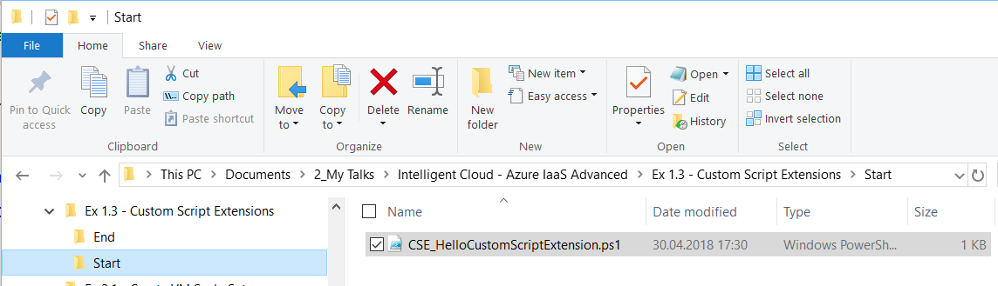
1.3 Custom Script Extensions – Part I
Ex 1.3 -> Start -> Open and review CSE_HelloCustomScriptExtension…
Attach it to your VM using the portal. Portal -> VM -> Extension -> Custom Script Extension
Log on to your VM – have a look at: C:\Packages\Plugins\Microsoft.Compute.CustomScriptExtension
And later to C:\temp

Slide 17
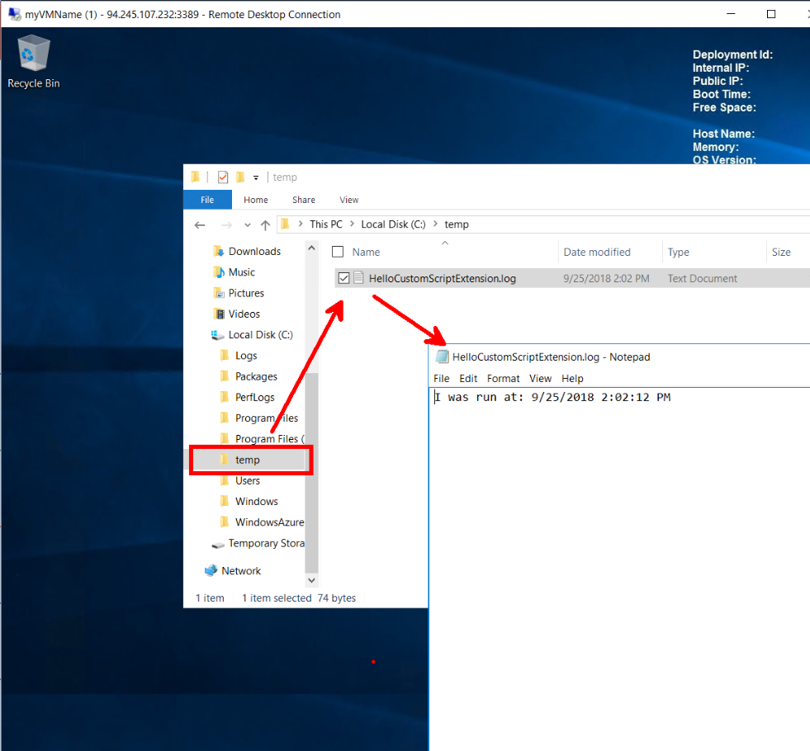
Ergebnis Logdatei mit Zeitstempel in der Azure VM 1.3 Custom Script Extensions – Part I

Slide 18
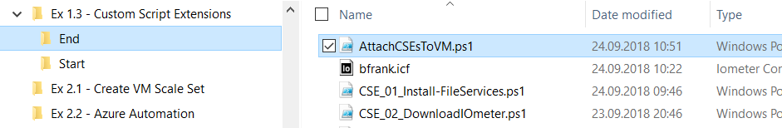
1.3 Custom Script Extensions – Part II
Ex 1.3 -> End -> Open and review AttachCSEsToVM.ps1…
What is it doing ?
Try to run it. Why is it not working ?
-> Solve the problem and run it again

Slide 19
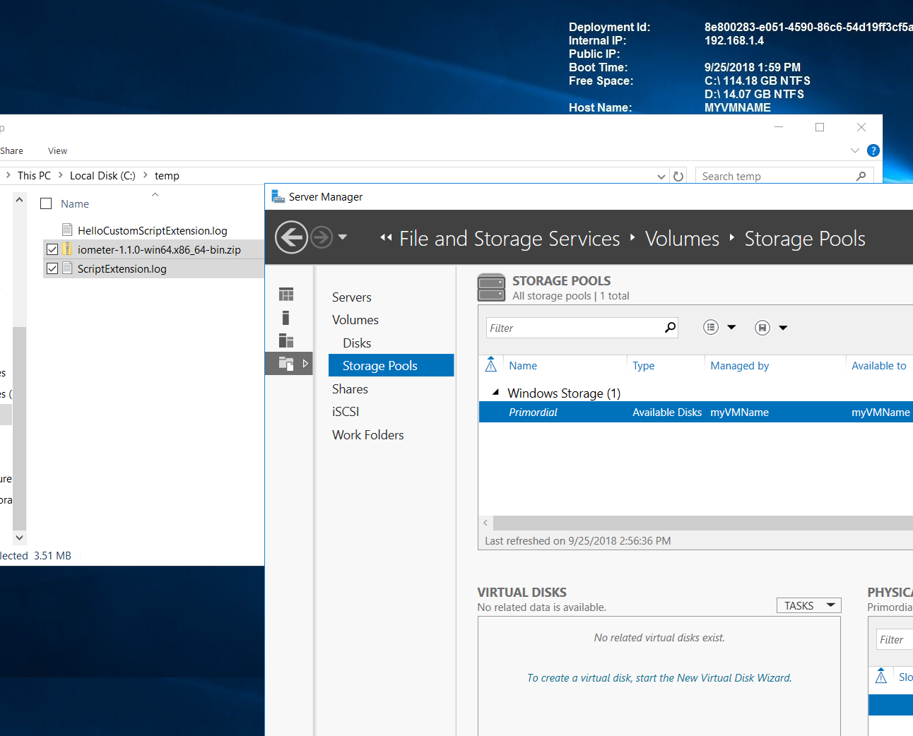
Ergebnis - iometer.zip Datei vorhanden - File server features installiert 1.3 Custom Script Extensions – Part II

Slide 20
1.3 Custom Script Extensions Fragen…
Wieviele Custom Script Extensions kann eine VM haben?
Kann man bei CSE mit Parametern arbeiten?
Sind Benutzerabfragen in CSEs sinnvoll?
Wann returniert ein CSE?
Notes:
A1: Immer nur eine (nach der Anderen)
A2: Ja. Bei Set-AzureRmVMCustomScriptExtension -Argument ....
A3: Nein, denn sie blockieren die Ausführung und man kann nichts eingeben.
A4: Dann wann der PowerShell Code die Ausführung zurückgibt. D.h. es kann durchaus sein dass Dinge weiterlaufen auch wenn die CSE bereits ‘fertig’ ist. BTW vorsicht mit reboots (e.g. domain joins…)

Slide 21
1.4 IOPS Benchmarking - Iometer Test
Instructor fragen….;-)

Slide 22
1.4 IOPS Benchmarking - Iometer Test Fragen…
Wie skaliert die Performance über mehrere Datendisks?
Ist ein Diskmanager stripe set genauso gut wie ein Storage Space?
Notes:
A1: Indem man die Datendisks zusammenfasst. Vorsicht auch hier hat man grenzen über den VM Typen. Nicht ganz linear.
A2: Performance in etwa gleich. Vorteil beim Storage Space ist dass man Disks nachträglich hinzufügen kann.

Slide 23
VM Scale Sets
High performance provisioning of 1000+ VMs
Auto-configuration at scale
Auto-scale based on schedule and resource metrics
Easy updates at scale
Simple Portal Integration

Slide 24
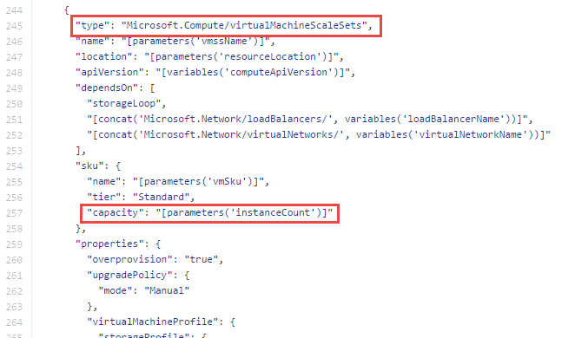
Why VM Scale Sets?
Manually scale with ‘capacity’ property
Autoscale with host metrics (MDM pipeline) or diagnostic extensions​
Small buy-in: Deploy/manage sets of 0 → 100 identically configured VMs ​
Guest OS patching: Patching primitives allow manually triggered rolling upgrades​​
High-availability – Implicit availability set with 5 FDs/5 UDs​
Availability Sets vs Scale Sets
Avail Set: Multiple different VMs (image, size, etc.); managed separately
Scale Set: Large count of the same VMs; managed together
Scale set: Reliable rapid provisioning and scale utilizing similarity of the VMs

Slide 25
2.1 Create VM Scale Set
When using PowerShell start here…
or portal to create a VM Scale Set (VMSS):
2 Windows instances
Create a new resource group ‘Ex2-RG’
New VNET (10.1.0.0/16) + Subnets 10.1.1.0/24
A Loadbalancer Standard with a static public IP
LB-Rule to forward http traffic (port 80)
Allow RDP traffic into VMs

Slide 26
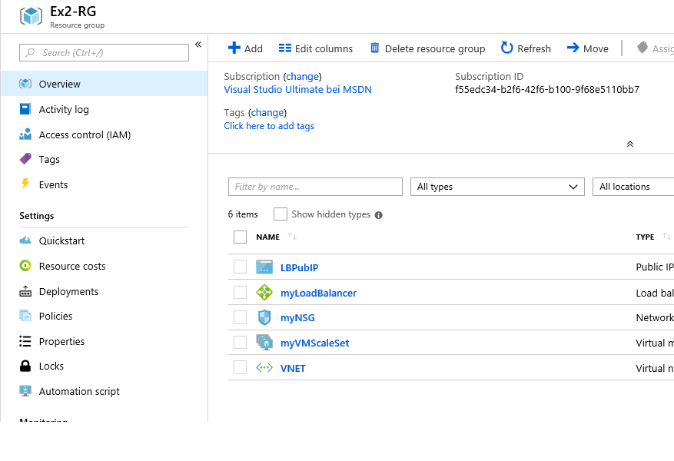
Ergebnis
2.1 Create VM Scale Set

Slide 27
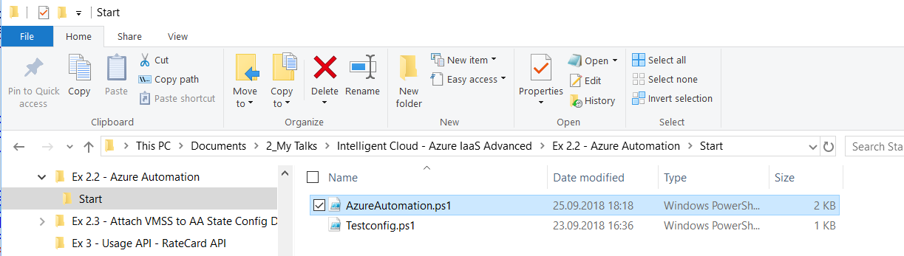
2.2 Azure Automation
Use PowerShell and start here…
Load AzureAutomation.ps1 into ISE review & execute step by step – verify what is happening in Azure portal

Slide 28
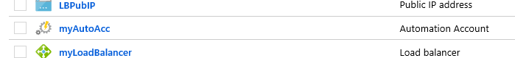
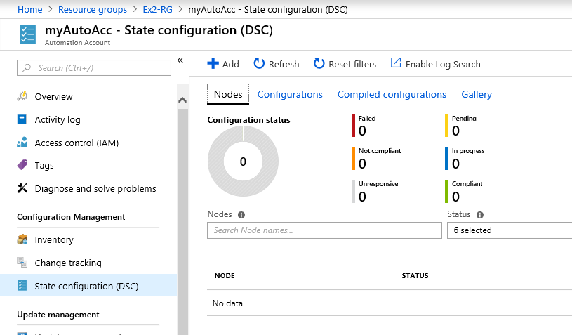
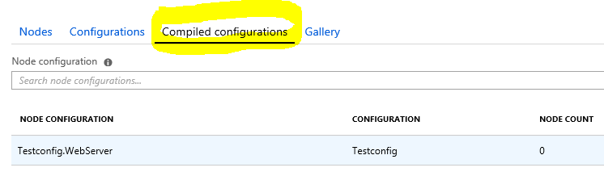
Ergebnis
2.2 Azure Automation

Slide 29
2.2 Azure Automation Fragen…
Was macht die Konfiguration Testconfig.webserver ?
Was passiert beim Kompilieren der Konfiguration?
Notes:
A1: Sie sorgt dafür dass die Maschine auf der sie ausgeführt wird der IIS installiert wird
A2: Aus der PS Code wird eine Konfigurations (MOF configuration documents) datei die auf einen Azure Automation State Configuration Pull Server bereitgestellt wird.

Slide 30
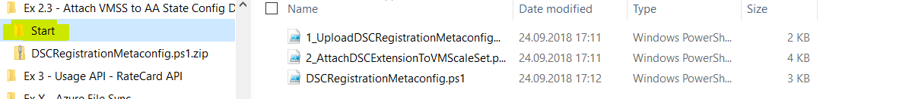
2.3 Attach VMSS to AA State Config DSC
Use PowerShell and start here…
Load 1_UploadDSCRegistrationMetaconfigScriptToSAContainer.ps1 into ISE review
-> tell instructor

Slide 31
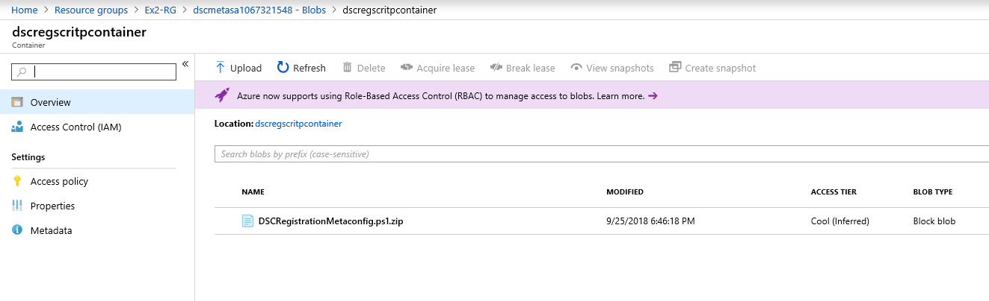
1_UploadDSCRegistrationMetaconfigScriptToSAContainer.ps1
Just creates a blob to host the meta config script, so that a VM can reach it via https: e.g.
https://dscmetasa1067321548.blob.core.windows.net/dscregscritpcontainer/DSCRegistrationMetaconfig.ps1.zip

Slide 32
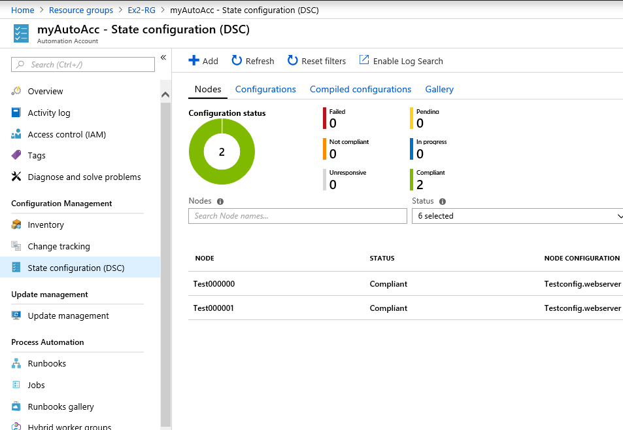
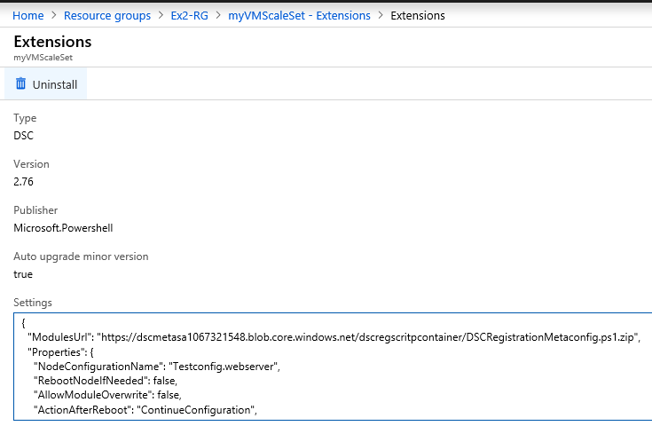
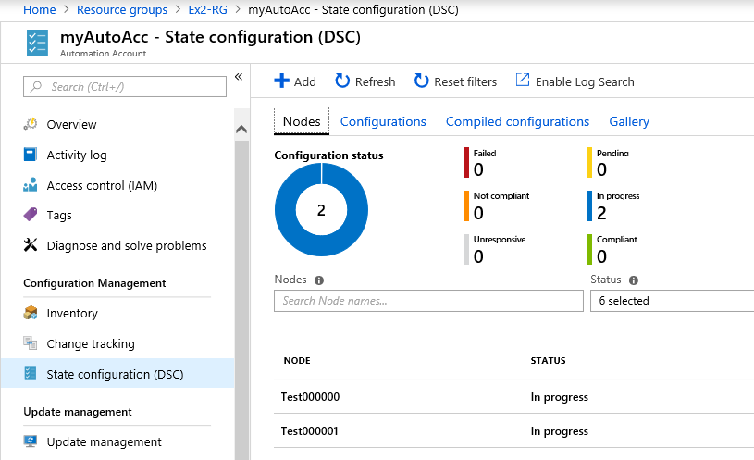
2_AttachDSCExtensionToVMScaleSet.ps1
Registers the PowerShell DSC (Desired State Configuration) Extension to the VM Scale Set
passes parameters to Extension so that it calls DSCRegistrationMetaconfig.ps1.zip
From e.g. https://dscmetasa1067321548.blob.core.windows.net/dscregscritpcontainer/DSCRegistrationMetaconfig.ps1.zip
To register against Azure Automation Account and report against compiled Configuration

Slide 33
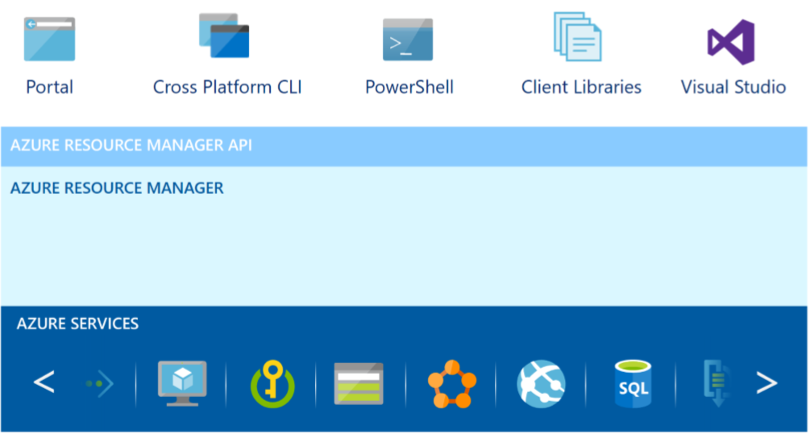
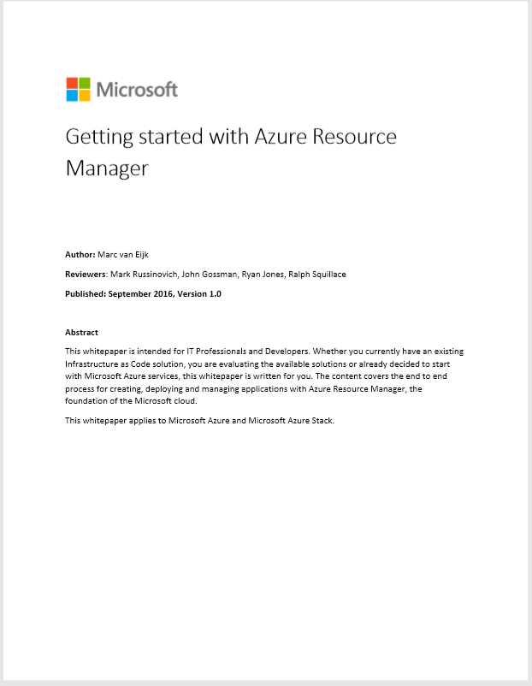
Azure Resource Manager (ARM)
Provides a management layer to create and operate your Azure resources
Azure cloud platform provided can be divided into 4 layers:
End-user experience
Unified Application model
Services
Cloud infrastructure
*) Getting started with Azure Resource Manager
*)
Notes:
https://docs.microsoft.com/en-us/azure/azure-resource-man
resource - A manageable item that is available through Azure. Some common resources are a virtual machine, storage account, web app, database, and virtual network, but there are many more.
resource group - A container that holds related resources for an Azure solution. The resource group can include all the resources for the solution, or only those resources that you want to manage as a group. You decide how you want to allocate resources to resource groups based on what makes the most sense for your organization. See Resource groups.
resource provider - A service that supplies the resources you can deploy and manage through Resource Manager. Each resource provider offers operations for working with the resources that are deployed. Some common resource providers are Microsoft.Compute, which supplies the virtual machine resource, Microsoft.Storage, which supplies the storage account resource, and Microsoft.Web, which supplies resources related to web apps. See Resource providers.
Resource Manager template - A JavaScript Object Notation (JSON) file that defines one or more resources to deploy to a resource group. It also defines the dependencies between the deployed resources. The template can be used to deploy the resources consistently and repeatedly. See Template deployment.
declarative syntax - Syntax that lets you state "Here is what I intend to create" without having to write the sequence of programming commands to create it. The Resource Manager template is an example of declarative syntax. In the file, you define the properties for the infrastructure to deploy to Azure.
ager/resource-group-overview

Slide 34

Partner Technical (Presales) Support depts@microsoft.com

